Slide 1
Multimodal fitting of atypical size distributions from AERONET
Michael Taylor
Stelios Kazadzis
Evangelos Gerasopoulos
URL: http://apcg.meteo.noa.gr
eMail: mtaylor@noa.gr
OVERVIEW
Typical & atypical distributions
Two new fitting methods
An interesting new case
Potential impact & a wish list ☺
Michael Taylor, COMECAP 29th May, 2014: Remote Sensing Session

Slide 2
1. Typical & atypical distributions
Michael Taylor, COMECAP 29th May, 2014: Remote Sensing Session
Notes:
Radiative forcing estimates in 2011 relative to 1750 and aggregated uncertainties for the
main drivers of climate change. Values are global average radiative forcing (RF15) partitioned according to
the emitted compounds or processes that result in a combination of drivers. The best estimates of the net
radiative forcing are shown as black diamonds with corresponding uncertainty intervals; the numerical values
are provided on the right of the figure, together with the confidence level in the net forcing (VH – very high, H
– high, M – medium, L – low, VL – very low). Albedo forcing due to black carbon on snow and ice is included
in the black carbon aerosol bar. Small forcings due to contrails (0.05 W m–2, including contrail induced
cirrus), and HFCs, PFCs and SF6 (total 0.03 W m–2) are not shown. Concentration-based RFs for gases can
be obtained by summing the like-coloured bars. Volcanic forcing is not included as its episodic nature makes
is difficult to compare to other forcing mechanisms. Total anthropogenic radiative forcing is provided for three
different years relative to 1750. For further technical details, including uncertainty ranges associated with
individual components and processes, see the Technical Summary Supplementary Material. {8.5; Figures
8.14–8.18; Figures TS.6 and TS.7}

Slide 3
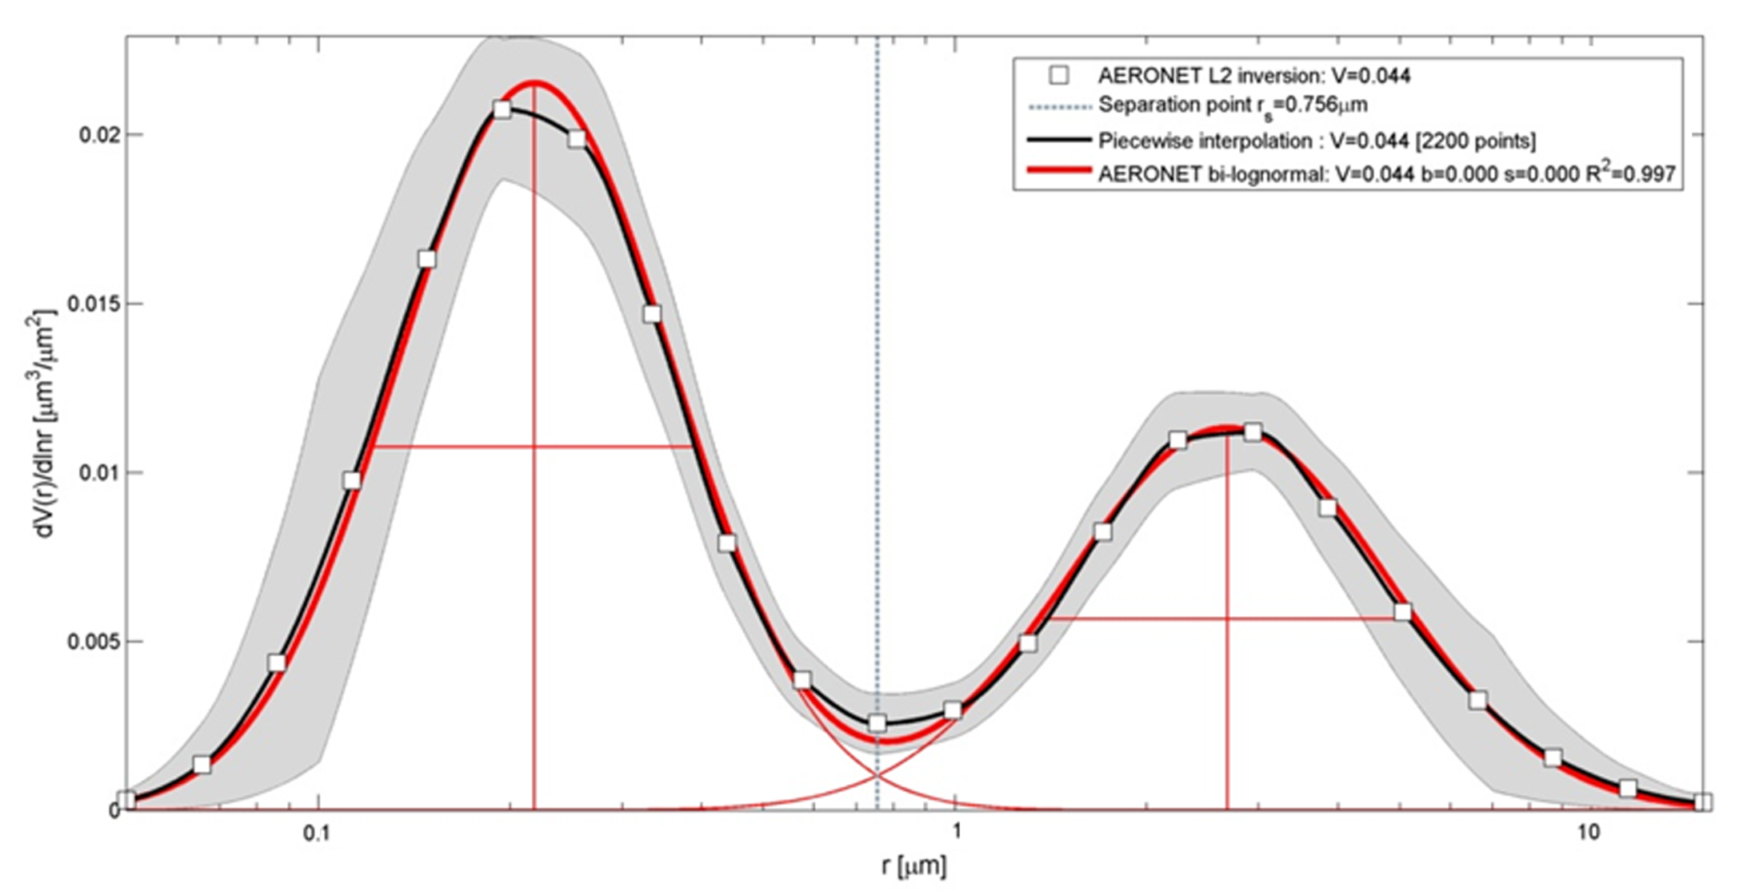
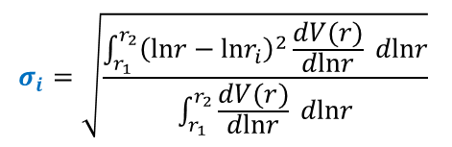
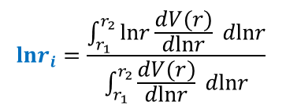
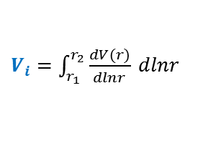
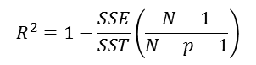
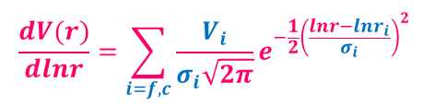
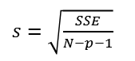
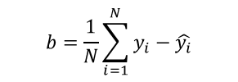
1a) A typical (bi-modal) size distribution
ε=10%
Fresno (8th Feb 2006)
0.439 ≤ r_{s} ≤ 0.992μm
AERONET mode
separation range
$$b=\frac{1}{N}\sum_{i=1}^{N}{y_{i}−\hat{y_{i}}}$$
$$\frac{dV(r)}{dlnr}=\sum_{i=f,c}{\frac{V_{i}}{σ_{i}\sqrt{2π}}e^{−\frac{1}{2}{\left(\frac{lnr−lnr_{i}}{σ_{i}}\right)}^{2}}}$$
ε=100%
ε=10%
$s=\sqrt{\frac{SSE}{N−p−1}}$
σ_{f}
$$R^{2}=1−\frac{SSE}{SST}\left(\frac{N−1}{N−p−1}\right)$$
ε=100%
ε=35%
σ_{c}
Fine Mode: V_{f}
Coarse Mode: V_{c}
r_{f}
r_{c}
$$lnr_{i}=\frac{\int_{r_{1}}^{r_{2}}{lnr\frac{dV(r)}{dlnr}} dlnr}{\int_{r_{1}}^{r_{2}}{\frac{dV(r)}{dlnr}} dlnr}$$
$$σ_{i}=\sqrt{\frac{\int_{r_{1}}^{r_{2}}{{\left(lnr−lnr_{i}\right)}^{2}\frac{dV(r)}{dlnr}} dlnr}{\int_{r_{1}}^{r_{2}}{\frac{dV(r)}{dlnr}} dlnr}}$$
$V_{i}=\int_{r_{1}}^{r_{2}}{\frac{dV(r)}{dlnr}} dlnr$
Michael Taylor, COMECAP 29th May, 2014: Remote Sensing Session

Slide 4
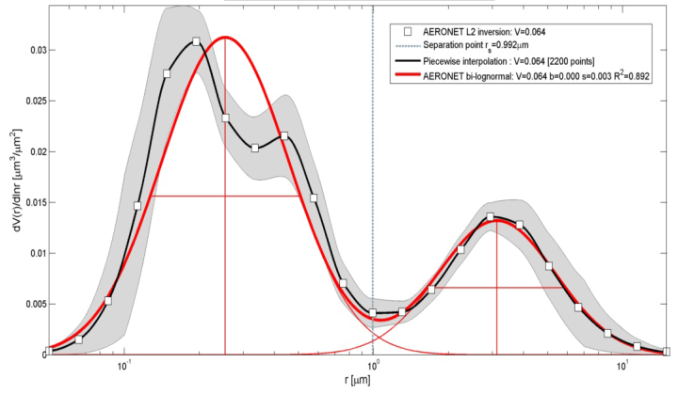
1a) 2 days later…
Fresno (10th Feb 2006)
r=0.19μm
r=0.26μm
r=0.44μm
mis-identification of “fine” modes
creation of a “ghost” (non-physical) fine mode
drop in goodness of fit: R²=0.997 → R²=0.892
Michael Taylor, COMECAP 29th May, 2014: Remote Sensing Session
Notes:
Radiative forcing estimates in 2011 relative to 1750 and aggregated uncertainties for the
main drivers of climate change. Values are global average radiative forcing (RF15) partitioned according to
the emitted compounds or processes that result in a combination of drivers. The best estimates of the net
radiative forcing are shown as black diamonds with corresponding uncertainty intervals; the numerical values
are provided on the right of the figure, together with the confidence level in the net forcing (VH – very high, H
– high, M – medium, L – low, VL – very low). Albedo forcing due to black carbon on snow and ice is included
in the black carbon aerosol bar. Small forcings due to contrails (0.05 W m–2, including contrail induced
cirrus), and HFCs, PFCs and SF6 (total 0.03 W m–2) are not shown. Concentration-based RFs for gases can
be obtained by summing the like-coloured bars. Volcanic forcing is not included as its episodic nature makes
is difficult to compare to other forcing mechanisms. Total anthropogenic radiative forcing is provided for three
different years relative to 1750. For further technical details, including uncertainty ranges associated with
individual components and processes, see the Technical Summary Supplementary Material. {8.5; Figures
8.14–8.18; Figures TS.6 and TS.7}

Slide 5
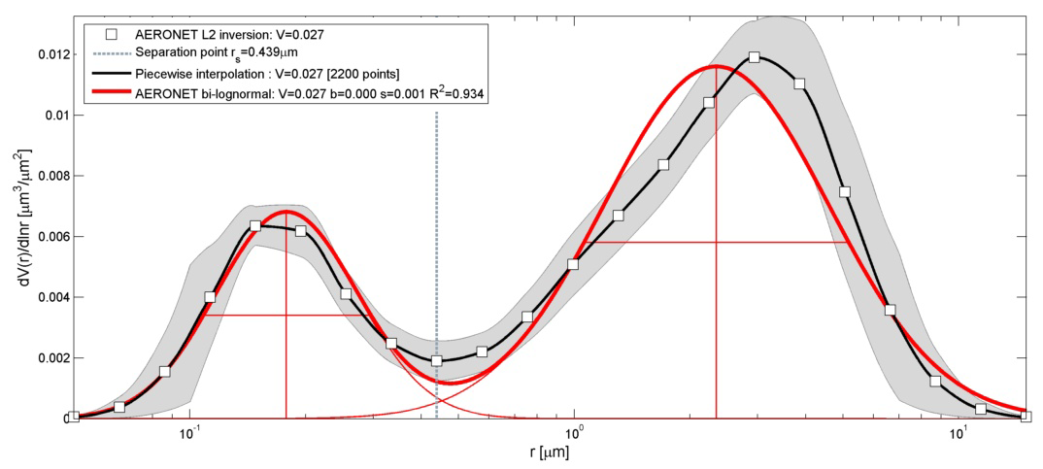
1a) another typical (bi-modal) size distribution
Lanai (11th Jan 2002)
Michael Taylor, COMECAP 29th May, 2014: Remote Sensing Session

Slide 6
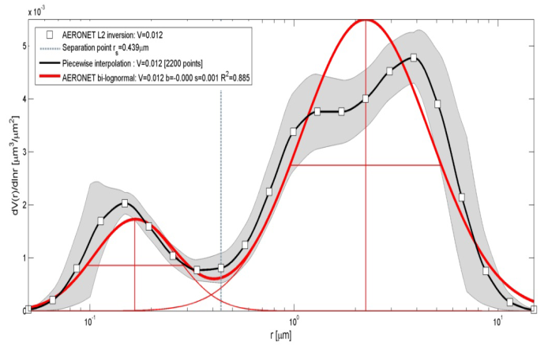
1a) 10 days later…
Lanai (21st Jan 2002)
r=1.35μm
r=1.92μm
r=4.1μm
mis-identification of “coarse” mode(s)
creation of a “ghost” (non-physical) coarse mode
drop in goodness of fit: R²=0.934 → R²=0.885
Michael Taylor, COMECAP 29th May, 2014: Remote Sensing Session
Notes:
Radiative forcing estimates in 2011 relative to 1750 and aggregated uncertainties for the
main drivers of climate change. Values are global average radiative forcing (RF15) partitioned according to
the emitted compounds or processes that result in a combination of drivers. The best estimates of the net
radiative forcing are shown as black diamonds with corresponding uncertainty intervals; the numerical values
are provided on the right of the figure, together with the confidence level in the net forcing (VH – very high, H
– high, M – medium, L – low, VL – very low). Albedo forcing due to black carbon on snow and ice is included
in the black carbon aerosol bar. Small forcings due to contrails (0.05 W m–2, including contrail induced
cirrus), and HFCs, PFCs and SF6 (total 0.03 W m–2) are not shown. Concentration-based RFs for gases can
be obtained by summing the like-coloured bars. Volcanic forcing is not included as its episodic nature makes
is difficult to compare to other forcing mechanisms. Total anthropogenic radiative forcing is provided for three
different years relative to 1750. For further technical details, including uncertainty ranges associated with
individual components and processes, see the Technical Summary Supplementary Material. {8.5; Figures
8.14–8.18; Figures TS.6 and TS.7}

Slide 7
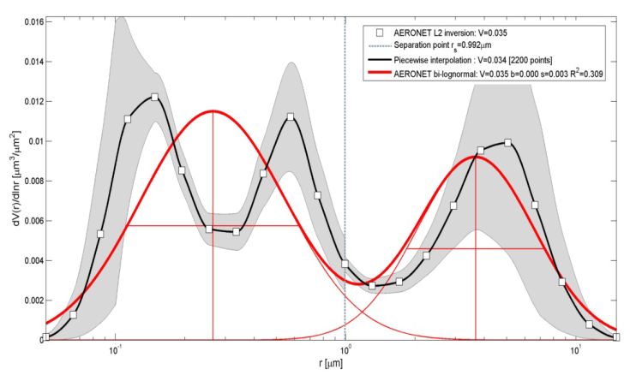
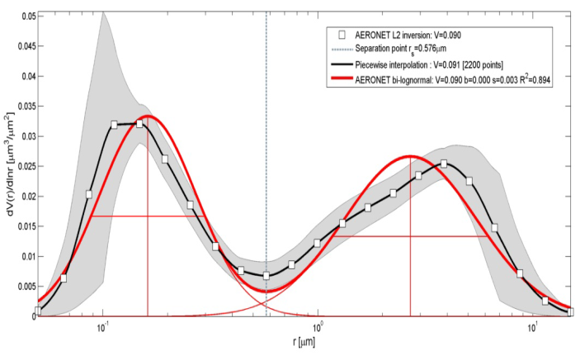
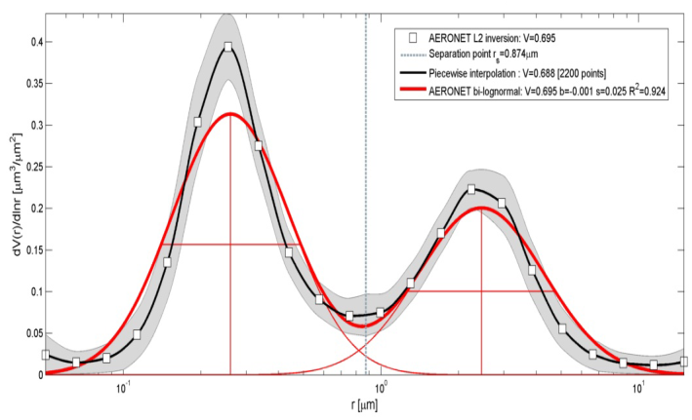
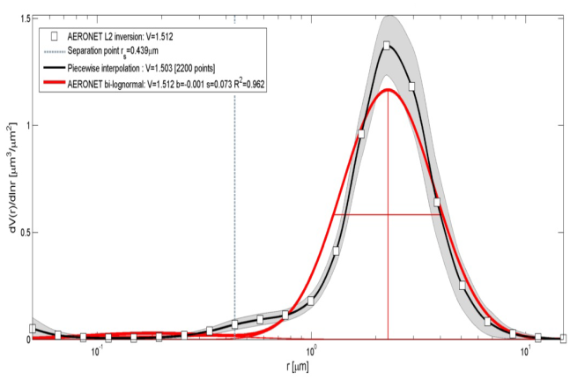
1b) IDEA: an initial taxonomy of atypical distributions
Washington-GSFC (23th Jun 1993)
Triple peak (Pinatubo ash effect)
Lanai (21st Jan 2002)
Double-coarse peak
Fresno (10th Feb 2006)
Double-fine peak
Beijing (18th Feb 2011)
Skewed fine & coarse peaks
Beijing (23th Feb 2011)
Elevated mid-point
Solar Village (29th Mar 2011)
Quenched fine mode
Q. Anyone interested in collaborating to extend our database of atypical events ?
Michael Taylor, COMECAP 29th May, 2014: Remote Sensing Session

Slide 8
1c) IDEA: can we use R² to detect atypical events?
AERONET Site | Date | Observation | R²
GSFC-Washington | 23-Jun-93 | Triple Peak | 0.309
Lanai | 20-Jan-02 | Double Coarse Peak | 0.833
Fresno | 10-Feb-06 | Double Fine Peak | 0.892
Beijing | 18-Feb-11 | Skewed Fine & Coarse Peaks | 0.894
Beijing | 23-Feb-11 | Elevated Mid-Point | 0.924
Solar Village | 29-Mar-11 | Quenched Fine Peak | 0.962
Frenso | 08-Feb-06 | Bi-modal | 0.997
Strongly atypical
Moderately atypical
Weakly atypical
Typical case
Michael Taylor, COMECAP 29th May, 2014: Remote Sensing Session

Slide 9
2. Two new fitting methods
Taylor, Kazadzis, Gerasopoulous (2014): AMT 7, 839-858
Michael Taylor, COMECAP 29th May, 2014: Remote Sensing Session
Notes:
Radiative forcing estimates in 2011 relative to 1750 and aggregated uncertainties for the
main drivers of climate change. Values are global average radiative forcing (RF15) partitioned according to
the emitted compounds or processes that result in a combination of drivers. The best estimates of the net
radiative forcing are shown as black diamonds with corresponding uncertainty intervals; the numerical values
are provided on the right of the figure, together with the confidence level in the net forcing (VH – very high, H
– high, M – medium, L – low, VL – very low). Albedo forcing due to black carbon on snow and ice is included
in the black carbon aerosol bar. Small forcings due to contrails (0.05 W m–2, including contrail induced
cirrus), and HFCs, PFCs and SF6 (total 0.03 W m–2) are not shown. Concentration-based RFs for gases can
be obtained by summing the like-coloured bars. Volcanic forcing is not included as its episodic nature makes
is difficult to compare to other forcing mechanisms. Total anthropogenic radiative forcing is provided for three
different years relative to 1750. For further technical details, including uncertainty ranges associated with
individual components and processes, see the Technical Summary Supplementary Material. {8.5; Figures
8.14–8.18; Figures TS.6 and TS.7}

Slide 10
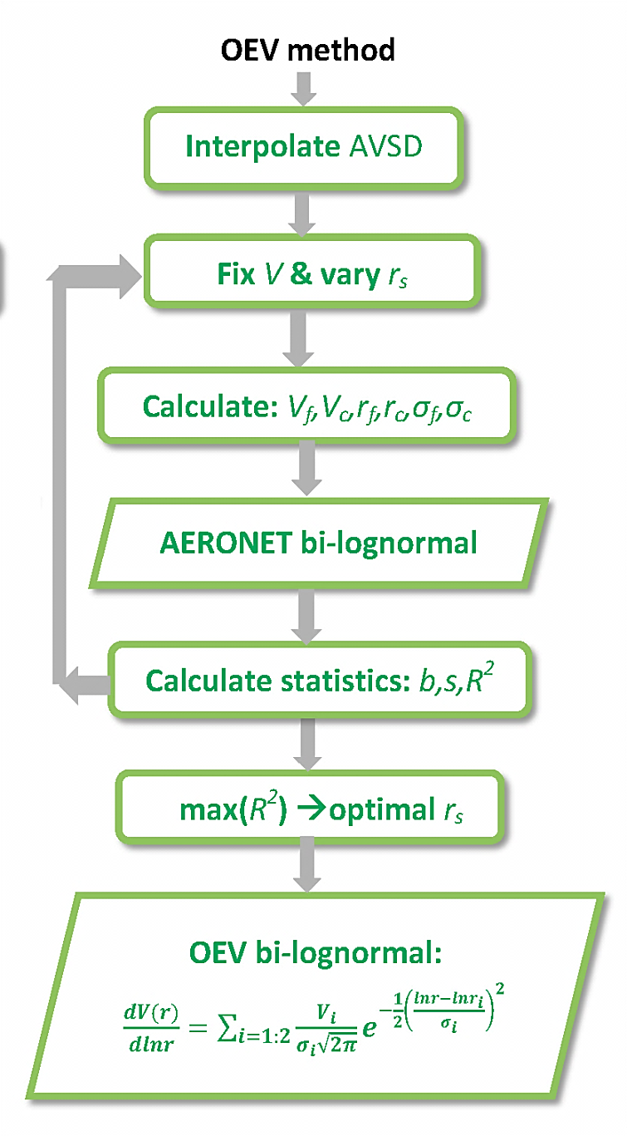
2a) Optimized Equivalent Volume (OEV) method
Lanai (21st Jan 2002)
Vary r_{s}
Michael Taylor, COMECAP 29th May, 2014: Remote Sensing Session

Slide 11
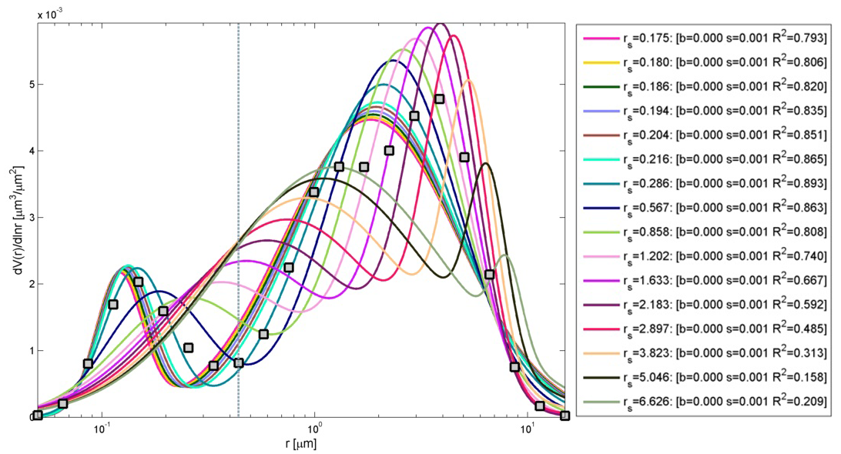
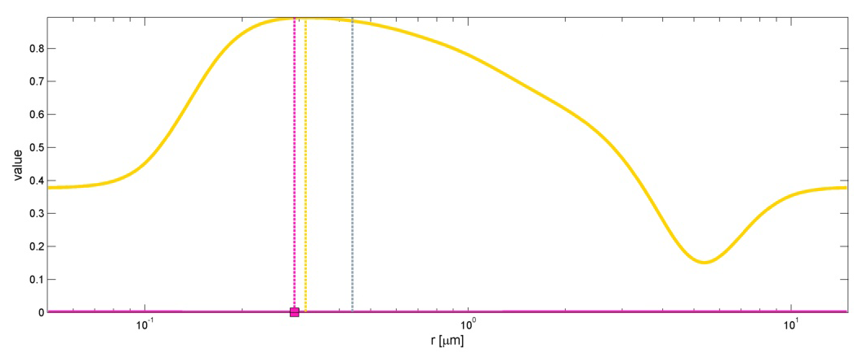
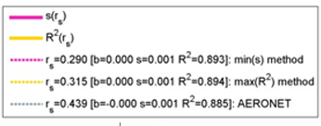
2a) OEV method: varying r_{s}
Max(R²) →criterion for identifying optimal r_{s}
Michael Taylor, COMECAP 29th May, 2014: Remote Sensing Session
Notes:
Radiative forcing estimates in 2011 relative to 1750 and aggregated uncertainties for the
main drivers of climate change. Values are global average radiative forcing (RF15) partitioned according to
the emitted compounds or processes that result in a combination of drivers. The best estimates of the net
radiative forcing are shown as black diamonds with corresponding uncertainty intervals; the numerical values
are provided on the right of the figure, together with the confidence level in the net forcing (VH – very high, H
– high, M – medium, L – low, VL – very low). Albedo forcing due to black carbon on snow and ice is included
in the black carbon aerosol bar. Small forcings due to contrails (0.05 W m–2, including contrail induced
cirrus), and HFCs, PFCs and SF6 (total 0.03 W m–2) are not shown. Concentration-based RFs for gases can
be obtained by summing the like-coloured bars. Volcanic forcing is not included as its episodic nature makes
is difficult to compare to other forcing mechanisms. Total anthropogenic radiative forcing is provided for three
different years relative to 1750. For further technical details, including uncertainty ranges associated with
individual components and processes, see the Technical Summary Supplementary Material. {8.5; Figures
8.14–8.18; Figures TS.6 and TS.7}

Slide 12
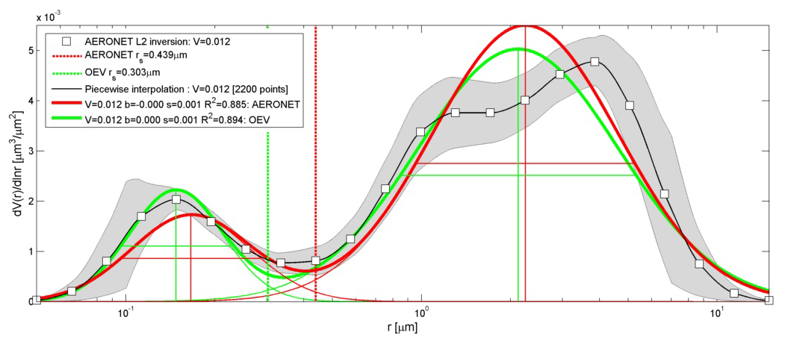
2a) OEV method: comparison with AERONET bi-modal
Lanai (21st Jan 2002)
TINY quantitative but not qualitative improvement
Michael Taylor, COMECAP 29th May, 2014: Remote Sensing Session
Notes:
Radiative forcing estimates in 2011 relative to 1750 and aggregated uncertainties for the
main drivers of climate change. Values are global average radiative forcing (RF15) partitioned according to
the emitted compounds or processes that result in a combination of drivers. The best estimates of the net
radiative forcing are shown as black diamonds with corresponding uncertainty intervals; the numerical values
are provided on the right of the figure, together with the confidence level in the net forcing (VH – very high, H
– high, M – medium, L – low, VL – very low). Albedo forcing due to black carbon on snow and ice is included
in the black carbon aerosol bar. Small forcings due to contrails (0.05 W m–2, including contrail induced
cirrus), and HFCs, PFCs and SF6 (total 0.03 W m–2) are not shown. Concentration-based RFs for gases can
be obtained by summing the like-coloured bars. Volcanic forcing is not included as its episodic nature makes
is difficult to compare to other forcing mechanisms. Total anthropogenic radiative forcing is provided for three
different years relative to 1750. For further technical details, including uncertainty ranges associated with
individual components and processes, see the Technical Summary Supplementary Material. {8.5; Figures
8.14–8.18; Figures TS.6 and TS.7}

Slide 13
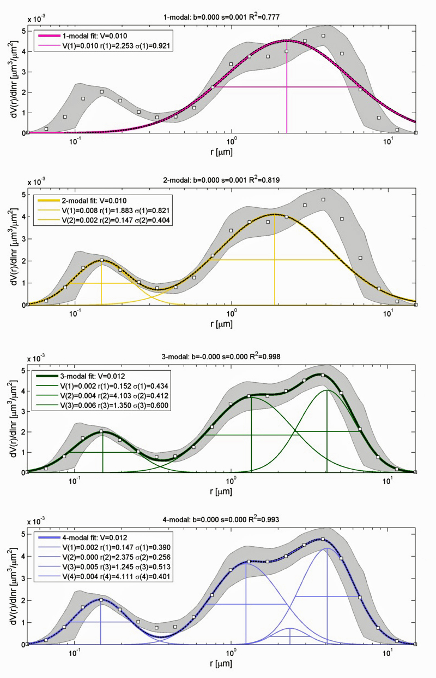
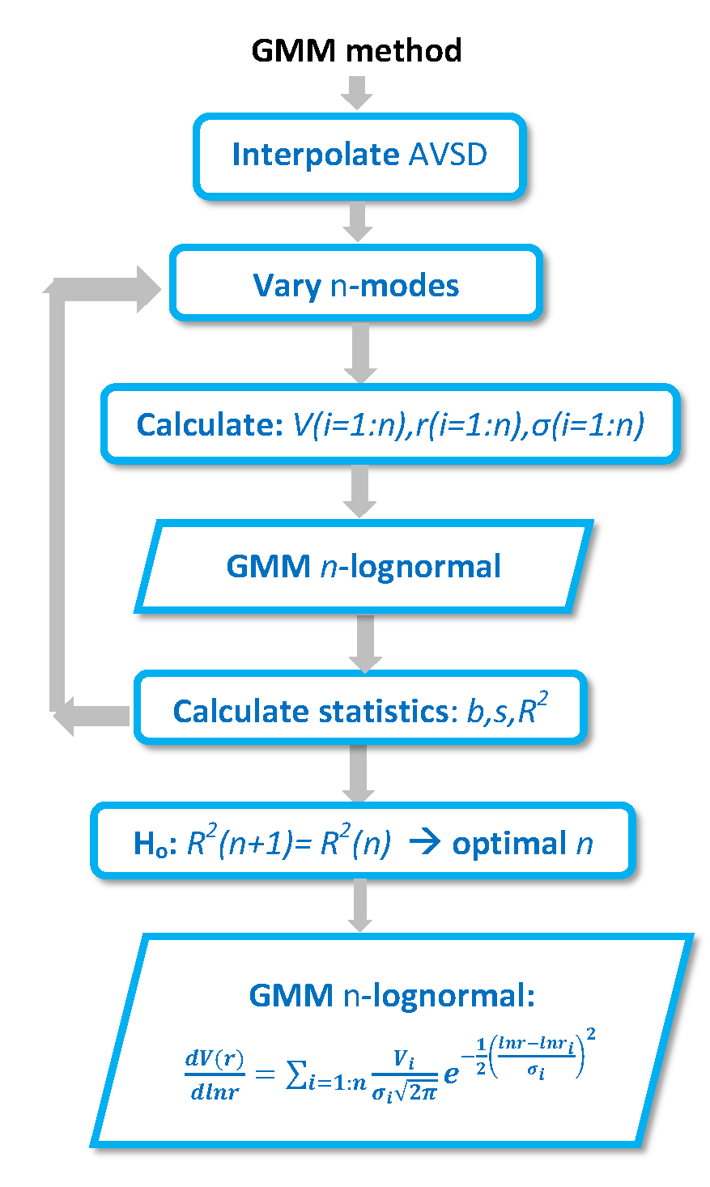
2b) Gaussian Mixture Model (GMM) method varying n-modes
Lanai (21st Jan 2002)
Michael Taylor, COMECAP 29th May, 2014: Remote Sensing Session
Notes:
Radiative forcing estimates in 2011 relative to 1750 and aggregated uncertainties for the
main drivers of climate change. Values are global average radiative forcing (RF15) partitioned according to
the emitted compounds or processes that result in a combination of drivers. The best estimates of the net
radiative forcing are shown as black diamonds with corresponding uncertainty intervals; the numerical values
are provided on the right of the figure, together with the confidence level in the net forcing (VH – very high, H
– high, M – medium, L – low, VL – very low). Albedo forcing due to black carbon on snow and ice is included
in the black carbon aerosol bar. Small forcings due to contrails (0.05 W m–2, including contrail induced
cirrus), and HFCs, PFCs and SF6 (total 0.03 W m–2) are not shown. Concentration-based RFs for gases can
be obtained by summing the like-coloured bars. Volcanic forcing is not included as its episodic nature makes
is difficult to compare to other forcing mechanisms. Total anthropogenic radiative forcing is provided for three
different years relative to 1750. For further technical details, including uncertainty ranges associated with
individual components and processes, see the Technical Summary Supplementary Material. {8.5; Figures
8.14–8.18; Figures TS.6 and TS.7}

Slide 14
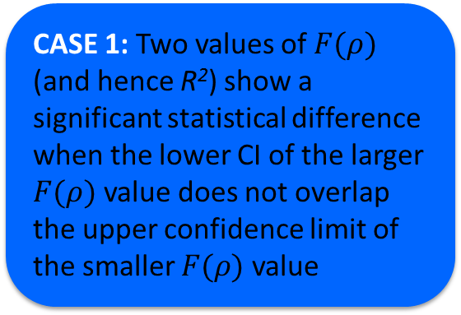
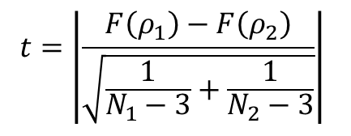
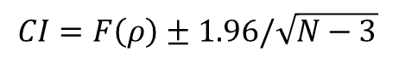
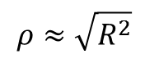
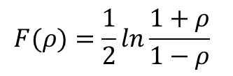
2b) GMM method: the stopping condition
$$ρ≈\sqrt{R^{2}}$$
Harel (2009): App Stat 36(10): 1109-1118
(maximum RE=0.060%)
$$F(ρ)=\frac{1}{2}ln\frac{1+ρ}{1−ρ}$$
Fisher (1921): Metron 1: 3–32
$$CI=F\left(ρ\right)±1.96/\sqrt{N−3}$$
(95% confidence level)
CASE 1: Two values of $F(ρ)$ (and hence R²) show a significant statistical difference when the lower CI of the larger $F(ρ)$ value does not overlap the upper confidence limit of the smaller $F(ρ)$ value
CASE 2: In the event of an overlap, there is a statistical difference when t>1.96
$$t=\left|\frac{F\left(ρ_{1}\right)−F\left(ρ_{2}\right)}{\sqrt{\frac{1}{N_{1}−3}+\frac{1}{N_{2}−3}}}\right|$$
Welch (1947): Biometrika 34 (1–2): 28–35
n Modes | R²(n) | R²(n+1) | F(ρ₁) | F(ρ₂) | CI₁(l) | CI₁(u) | CI₂(l) | CI₂(u) | t-Welch
1 | 0.777
2 | 0.777 | 0.819 | 1.38 | 1.50 | 1.34 | 1.54 | 1.46 | 1.54 | 3.87
3 | 0.819 | 0.998 | 1.50 | 3.80 | 1.46 | 3.84 | 3.76 | 3.84 | 76.26
4 | 0.998 | 0.993 | 3.80 | 3.17 | 3.76 | 3.21 | 3.13 | 3.21 | 20.80
Michael Taylor, COMECAP 29th May, 2014: Remote Sensing Session
Notes:
Radiative forcing estimates in 2011 relative to 1750 and aggregated uncertainties for the
main drivers of climate change. Values are global average radiative forcing (RF15) partitioned according to
the emitted compounds or processes that result in a combination of drivers. The best estimates of the net
radiative forcing are shown as black diamonds with corresponding uncertainty intervals; the numerical values
are provided on the right of the figure, together with the confidence level in the net forcing (VH – very high, H
– high, M – medium, L – low, VL – very low). Albedo forcing due to black carbon on snow and ice is included
in the black carbon aerosol bar. Small forcings due to contrails (0.05 W m–2, including contrail induced
cirrus), and HFCs, PFCs and SF6 (total 0.03 W m–2) are not shown. Concentration-based RFs for gases can
be obtained by summing the like-coloured bars. Volcanic forcing is not included as its episodic nature makes
is difficult to compare to other forcing mechanisms. Total anthropogenic radiative forcing is provided for three
different years relative to 1750. For further technical details, including uncertainty ranges associated with
individual components and processes, see the Technical Summary Supplementary Material. {8.5; Figures
8.14–8.18; Figures TS.6 and TS.7}

Slide 15
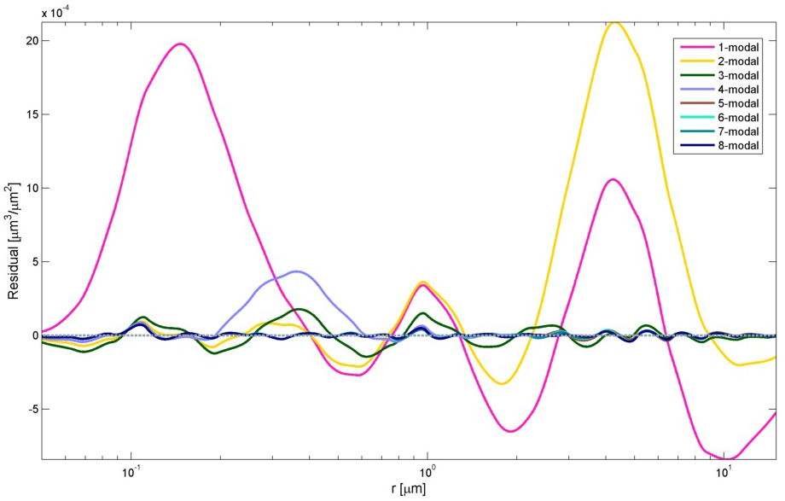
2b) GMM method: residual analysis
Lanai (21st Jan 2002)
LARGE reduction in residuals when n = 3 and a small increase when n = 4
Michael Taylor, COMECAP 29th May, 2014: Remote Sensing Session
Notes:
Radiative forcing estimates in 2011 relative to 1750 and aggregated uncertainties for the
main drivers of climate change. Values are global average radiative forcing (RF15) partitioned according to
the emitted compounds or processes that result in a combination of drivers. The best estimates of the net
radiative forcing are shown as black diamonds with corresponding uncertainty intervals; the numerical values
are provided on the right of the figure, together with the confidence level in the net forcing (VH – very high, H
– high, M – medium, L – low, VL – very low). Albedo forcing due to black carbon on snow and ice is included
in the black carbon aerosol bar. Small forcings due to contrails (0.05 W m–2, including contrail induced
cirrus), and HFCs, PFCs and SF6 (total 0.03 W m–2) are not shown. Concentration-based RFs for gases can
be obtained by summing the like-coloured bars. Volcanic forcing is not included as its episodic nature makes
is difficult to compare to other forcing mechanisms. Total anthropogenic radiative forcing is provided for three
different years relative to 1750. For further technical details, including uncertainty ranges associated with
individual components and processes, see the Technical Summary Supplementary Material. {8.5; Figures
8.14–8.18; Figures TS.6 and TS.7}

Slide 16
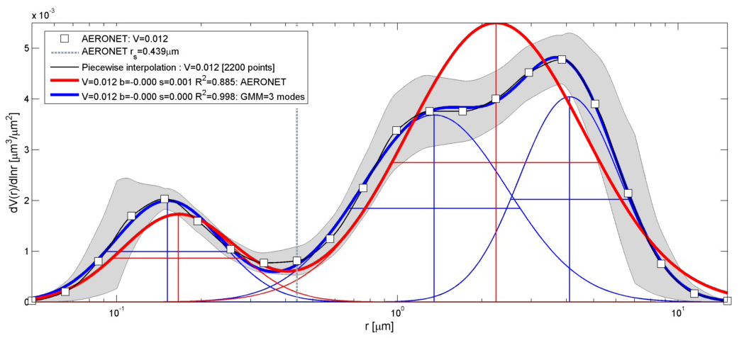
2b) GMM method: comparison with AERONET bi-modal
Lanai (21st Jan 2002)
LARGE quantitative and qualitative improvement
Michael Taylor, COMECAP 29th May, 2014: Remote Sensing Session
Notes:
Radiative forcing estimates in 2011 relative to 1750 and aggregated uncertainties for the
main drivers of climate change. Values are global average radiative forcing (RF15) partitioned according to
the emitted compounds or processes that result in a combination of drivers. The best estimates of the net
radiative forcing are shown as black diamonds with corresponding uncertainty intervals; the numerical values
are provided on the right of the figure, together with the confidence level in the net forcing (VH – very high, H
– high, M – medium, L – low, VL – very low). Albedo forcing due to black carbon on snow and ice is included
in the black carbon aerosol bar. Small forcings due to contrails (0.05 W m–2, including contrail induced
cirrus), and HFCs, PFCs and SF6 (total 0.03 W m–2) are not shown. Concentration-based RFs for gases can
be obtained by summing the like-coloured bars. Volcanic forcing is not included as its episodic nature makes
is difficult to compare to other forcing mechanisms. Total anthropogenic radiative forcing is provided for three
different years relative to 1750. For further technical details, including uncertainty ranges associated with
individual components and processes, see the Technical Summary Supplementary Material. {8.5; Figures
8.14–8.18; Figures TS.6 and TS.7}

Slide 17
3. An interesting new case
Michael Taylor, COMECAP 29th May, 2014: Remote Sensing Session
Notes:
Radiative forcing estimates in 2011 relative to 1750 and aggregated uncertainties for the
main drivers of climate change. Values are global average radiative forcing (RF15) partitioned according to
the emitted compounds or processes that result in a combination of drivers. The best estimates of the net
radiative forcing are shown as black diamonds with corresponding uncertainty intervals; the numerical values
are provided on the right of the figure, together with the confidence level in the net forcing (VH – very high, H
– high, M – medium, L – low, VL – very low). Albedo forcing due to black carbon on snow and ice is included
in the black carbon aerosol bar. Small forcings due to contrails (0.05 W m–2, including contrail induced
cirrus), and HFCs, PFCs and SF6 (total 0.03 W m–2) are not shown. Concentration-based RFs for gases can
be obtained by summing the like-coloured bars. Volcanic forcing is not included as its episodic nature makes
is difficult to compare to other forcing mechanisms. Total anthropogenic radiative forcing is provided for three
different years relative to 1750. For further technical details, including uncertainty ranges associated with
individual components and processes, see the Technical Summary Supplementary Material. {8.5; Figures
8.14–8.18; Figures TS.6 and TS.7}

Slide 18
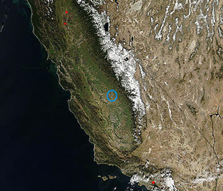
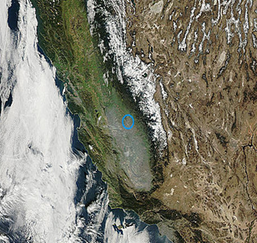
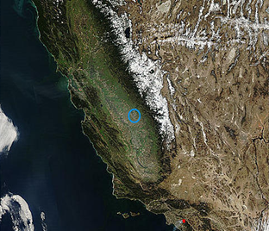
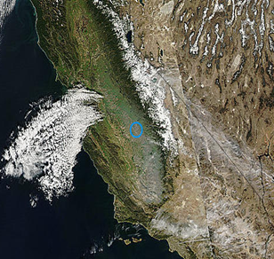
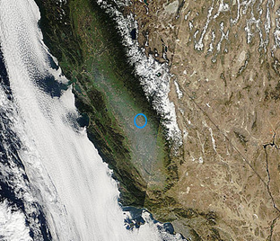
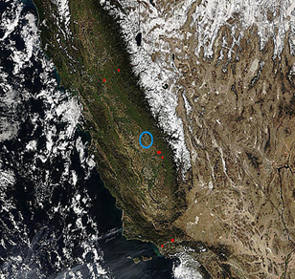
3a) Fresno: 8th–14th Feb 2006: MODIS 2km + aerosol props.
8th Feb 2006
11th Feb 2006
AERONET AOD Product Level 2 (Version 2)
9th Feb 2006
13th Feb 2006
GOCART V4 %AOD per aerosol type
10th Feb 2006
14th Feb 2006
Almost NO change in composition but
a LARGE change in H2O (x2)
Michael Taylor, COMECAP 29th May, 2014: Remote Sensing Session
Notes:
Radiative forcing estimates in 2011 relative to 1750 and aggregated uncertainties for the
main drivers of climate change. Values are global average radiative forcing (RF15) partitioned according to
the emitted compounds or processes that result in a combination of drivers. The best estimates of the net
radiative forcing are shown as black diamonds with corresponding uncertainty intervals; the numerical values
are provided on the right of the figure, together with the confidence level in the net forcing (VH – very high, H
– high, M – medium, L – low, VL – very low). Albedo forcing due to black carbon on snow and ice is included
in the black carbon aerosol bar. Small forcings due to contrails (0.05 W m–2, including contrail induced
cirrus), and HFCs, PFCs and SF6 (total 0.03 W m–2) are not shown. Concentration-based RFs for gases can
be obtained by summing the like-coloured bars. Volcanic forcing is not included as its episodic nature makes
is difficult to compare to other forcing mechanisms. Total anthropogenic radiative forcing is provided for three
different years relative to 1750. For further technical details, including uncertainty ranges associated with
individual components and processes, see the Technical Summary Supplementary Material. {8.5; Figures
8.14–8.18; Figures TS.6 and TS.7}

Slide 19
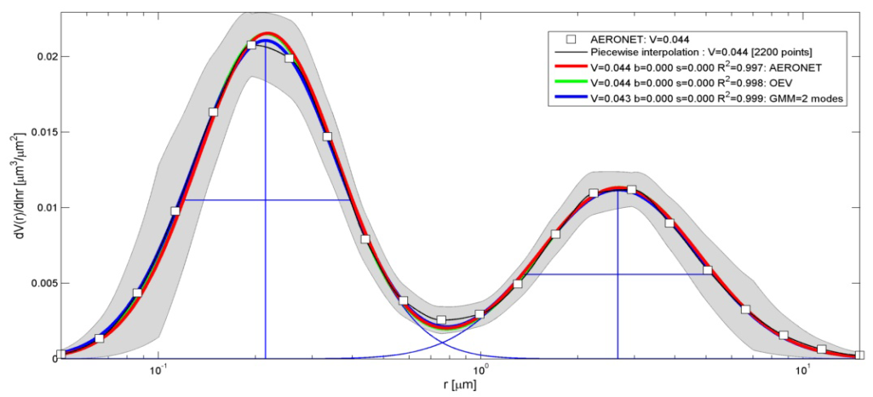
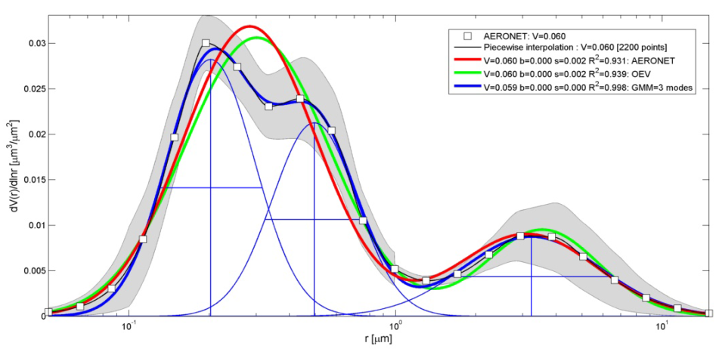
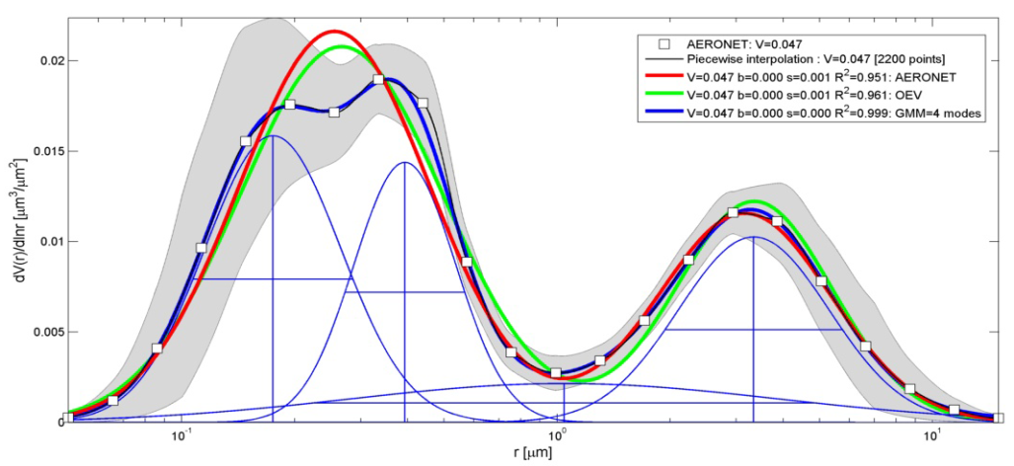
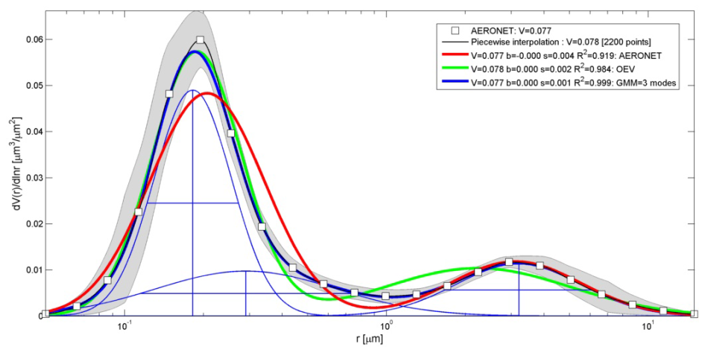
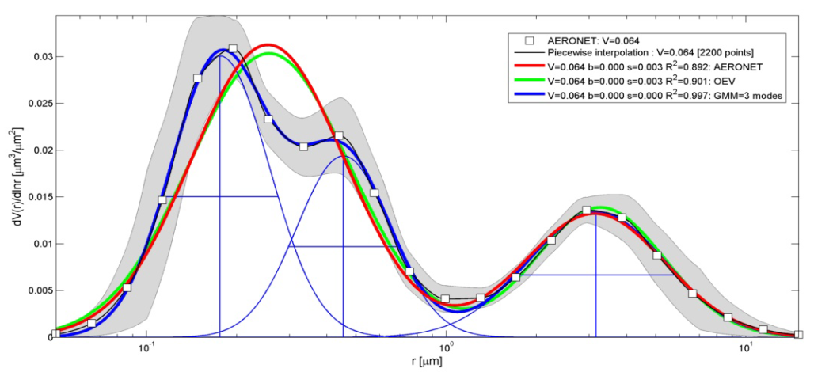
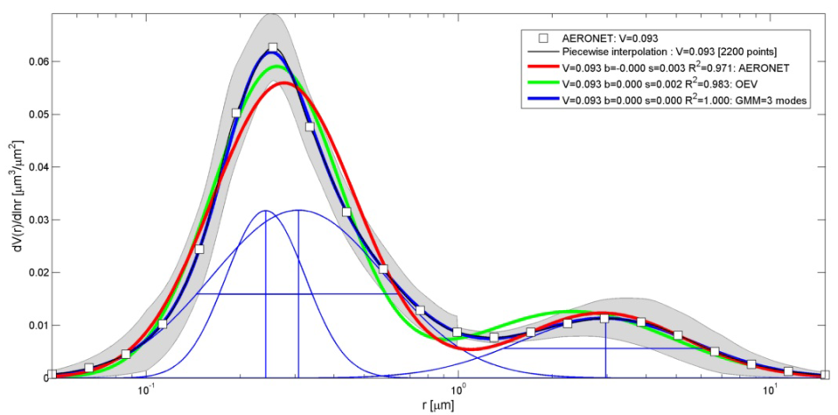
3a) Fresno 8th -14th Feb 2006 → Fog-induced modification
8th Feb
11th Feb
9th Feb
13th Feb
10th Feb
14th Feb
Michael Taylor, COMECAP 29th May, 2014: Remote Sensing Session
Notes:
Radiative forcing estimates in 2011 relative to 1750 and aggregated uncertainties for the
main drivers of climate change. Values are global average radiative forcing (RF15) partitioned according to
the emitted compounds or processes that result in a combination of drivers. The best estimates of the net
radiative forcing are shown as black diamonds with corresponding uncertainty intervals; the numerical values
are provided on the right of the figure, together with the confidence level in the net forcing (VH – very high, H
– high, M – medium, L – low, VL – very low). Albedo forcing due to black carbon on snow and ice is included
in the black carbon aerosol bar. Small forcings due to contrails (0.05 W m–2, including contrail induced
cirrus), and HFCs, PFCs and SF6 (total 0.03 W m–2) are not shown. Concentration-based RFs for gases can
be obtained by summing the like-coloured bars. Volcanic forcing is not included as its episodic nature makes
is difficult to compare to other forcing mechanisms. Total anthropogenic radiative forcing is provided for three
different years relative to 1750. For further technical details, including uncertainty ranges associated with
individual components and processes, see the Technical Summary Supplementary Material. {8.5; Figures
8.14–8.18; Figures TS.6 and TS.7}

Slide 20
4. Potential impacts
Michael Taylor, COMECAP 29th May, 2014: Remote Sensing Session
Notes:
Radiative forcing estimates in 2011 relative to 1750 and aggregated uncertainties for the
main drivers of climate change. Values are global average radiative forcing (RF15) partitioned according to
the emitted compounds or processes that result in a combination of drivers. The best estimates of the net
radiative forcing are shown as black diamonds with corresponding uncertainty intervals; the numerical values
are provided on the right of the figure, together with the confidence level in the net forcing (VH – very high, H
– high, M – medium, L – low, VL – very low). Albedo forcing due to black carbon on snow and ice is included
in the black carbon aerosol bar. Small forcings due to contrails (0.05 W m–2, including contrail induced
cirrus), and HFCs, PFCs and SF6 (total 0.03 W m–2) are not shown. Concentration-based RFs for gases can
be obtained by summing the like-coloured bars. Volcanic forcing is not included as its episodic nature makes
is difficult to compare to other forcing mechanisms. Total anthropogenic radiative forcing is provided for three
different years relative to 1750. For further technical details, including uncertainty ranges associated with
individual components and processes, see the Technical Summary Supplementary Material. {8.5; Figures
8.14–8.18; Figures TS.6 and TS.7}

Slide 21
4b) Potential impact: on AERONET & knock-on effects?
AERONET
inversions
Validation
Aerosol Typing (via OPAC)
?
1st Guess
IN SITU
chemistry
Regional models & GCMs
SATELLITE
retrievals
LIDAR
profiles
AERONET is a reference for:
validating satellite retrievals
assigning aerosol types
providing 1st guesses in “spin-ups”
Michael Taylor, COMECAP 29th May, 2014: Remote Sensing Session

Slide 22
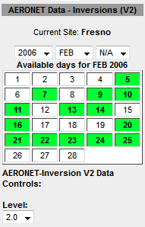
4) A wish list
More continuity in the AERONET inversion data record → to enable studies of the temporal evolution of atypical aerosol events
Establishment of a taxonomy database → to help detect, assess and monitor atypical events
Incorporation of our algorithm into operational algorithms & AERONET (inversion) data products
Your suggestions ☺
Many thanks to all our colleagues
Michael Taylor, IERSD-NOA
mtaylor@noa.gr
Michael Taylor, COMECAP 29th May, 2014: Remote Sensing Session
Notes:
Radiative forcing estimates in 2011 relative to 1750 and aggregated uncertainties for the
main drivers of climate change. Values are global average radiative forcing (RF15) partitioned according to
the emitted compounds or processes that result in a combination of drivers. The best estimates of the net
radiative forcing are shown as black diamonds with corresponding uncertainty intervals; the numerical values
are provided on the right of the figure, together with the confidence level in the net forcing (VH – very high, H
– high, M – medium, L – low, VL – very low). Albedo forcing due to black carbon on snow and ice is included
in the black carbon aerosol bar. Small forcings due to contrails (0.05 W m–2, including contrail induced
cirrus), and HFCs, PFCs and SF6 (total 0.03 W m–2) are not shown. Concentration-based RFs for gases can
be obtained by summing the like-coloured bars. Volcanic forcing is not included as its episodic nature makes
is difficult to compare to other forcing mechanisms. Total anthropogenic radiative forcing is provided for three
different years relative to 1750. For further technical details, including uncertainty ranges associated with
individual components and processes, see the Technical Summary Supplementary Material. {8.5; Figures
8.14–8.18; Figures TS.6 and TS.7}

Slide 23
EXTRA SLIDES
Michael Taylor, COMECAP 29th May, 2014: Remote Sensing Session
Notes:
Radiative forcing estimates in 2011 relative to 1750 and aggregated uncertainties for the
main drivers of climate change. Values are global average radiative forcing (RF15) partitioned according to
the emitted compounds or processes that result in a combination of drivers. The best estimates of the net
radiative forcing are shown as black diamonds with corresponding uncertainty intervals; the numerical values
are provided on the right of the figure, together with the confidence level in the net forcing (VH – very high, H
– high, M – medium, L – low, VL – very low). Albedo forcing due to black carbon on snow and ice is included
in the black carbon aerosol bar. Small forcings due to contrails (0.05 W m–2, including contrail induced
cirrus), and HFCs, PFCs and SF6 (total 0.03 W m–2) are not shown. Concentration-based RFs for gases can
be obtained by summing the like-coloured bars. Volcanic forcing is not included as its episodic nature makes
is difficult to compare to other forcing mechanisms. Total anthropogenic radiative forcing is provided for three
different years relative to 1750. For further technical details, including uncertainty ranges associated with
individual components and processes, see the Technical Summary Supplementary Material. {8.5; Figures
8.14–8.18; Figures TS.6 and TS.7}

Slide 24
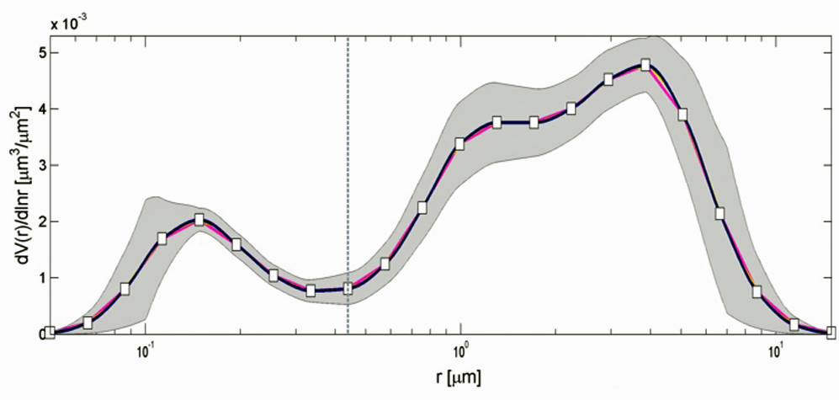
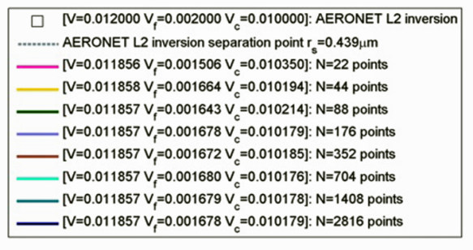
Errors on the AERONET retrieval
Lanai (21st Jan 2002)
Lanai (21st Jan 2002)
ε=10%
ε=100%
ε=100%
ε=10%
ε=35%
ε = reported AERONET error:
ε = 10% at fine & coarse peaks
ε = 35% at local minimum
ε = 100% at edges: r < 0.1μm or r > 7μm
Dubovik et al (2002)
N=2200 (x10 AERONET) gave best results for:
calculation of max(R²) in the OEV method
stabilization of the SE in the GMM method
Michael Taylor, COMECAP 29th May, 2014: Remote Sensing Session
Notes:
Radiative forcing estimates in 2011 relative to 1750 and aggregated uncertainties for the
main drivers of climate change. Values are global average radiative forcing (RF15) partitioned according to
the emitted compounds or processes that result in a combination of drivers. The best estimates of the net
radiative forcing are shown as black diamonds with corresponding uncertainty intervals; the numerical values
are provided on the right of the figure, together with the confidence level in the net forcing (VH – very high, H
– high, M – medium, L – low, VL – very low). Albedo forcing due to black carbon on snow and ice is included
in the black carbon aerosol bar. Small forcings due to contrails (0.05 W m–2, including contrail induced
cirrus), and HFCs, PFCs and SF6 (total 0.03 W m–2) are not shown. Concentration-based RFs for gases can
be obtained by summing the like-coloured bars. Volcanic forcing is not included as its episodic nature makes
is difficult to compare to other forcing mechanisms. Total anthropogenic radiative forcing is provided for three
different years relative to 1750. For further technical details, including uncertainty ranges associated with
individual components and processes, see the Technical Summary Supplementary Material. {8.5; Figures
8.14–8.18; Figures TS.6 and TS.7}

Slide 25
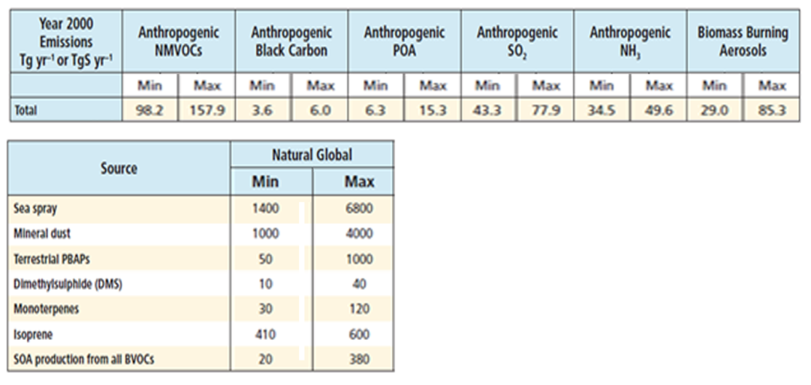
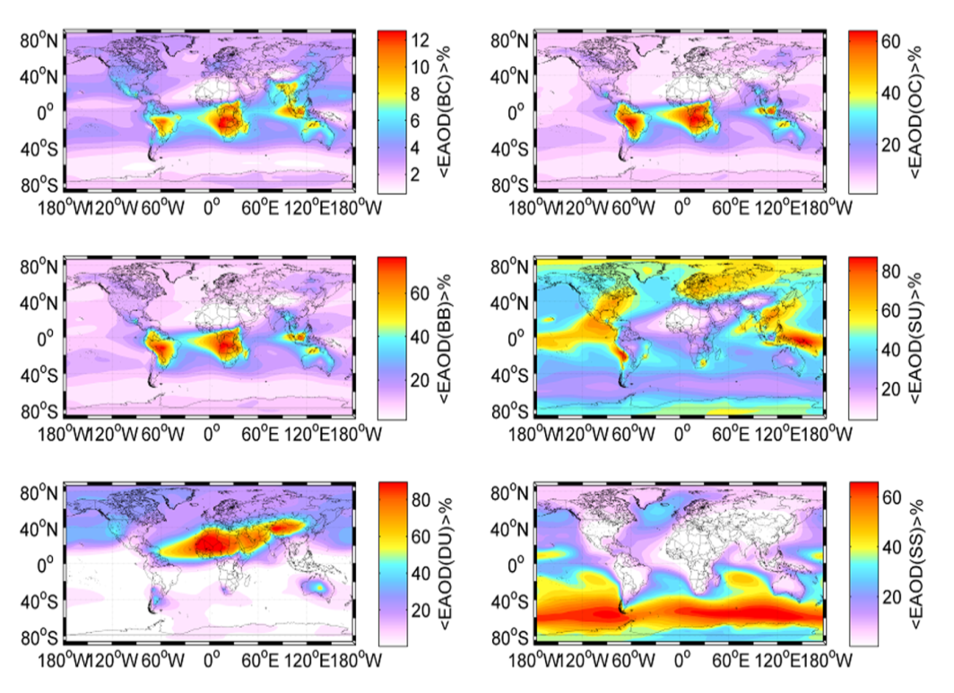
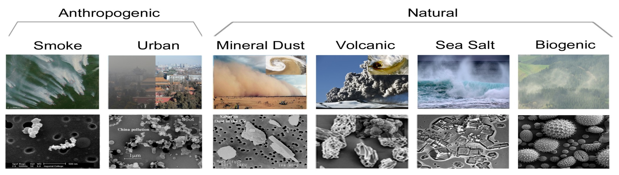
Using GOCART to isolate events
GOCART 2000-2006 global mean AOD per type
Source: IPCC/AR5 (2013)
Michael Taylor, COMECAP 29th May, 2014: Remote Sensing Session
Notes:
Radiative forcing estimates in 2011 relative to 1750 and aggregated uncertainties for the
main drivers of climate change. Values are global average radiative forcing (RF15) partitioned according to
the emitted compounds or processes that result in a combination of drivers. The best estimates of the net
radiative forcing are shown as black diamonds with corresponding uncertainty intervals; the numerical values
are provided on the right of the figure, together with the confidence level in the net forcing (VH – very high, H
– high, M – medium, L – low, VL – very low). Albedo forcing due to black carbon on snow and ice is included
in the black carbon aerosol bar. Small forcings due to contrails (0.05 W m–2, including contrail induced
cirrus), and HFCs, PFCs and SF6 (total 0.03 W m–2) are not shown. Concentration-based RFs for gases can
be obtained by summing the like-coloured bars. Volcanic forcing is not included as its episodic nature makes
is difficult to compare to other forcing mechanisms. Total anthropogenic radiative forcing is provided for three
different years relative to 1750. For further technical details, including uncertainty ranges associated with
individual components and processes, see the Technical Summary Supplementary Material. {8.5; Figures
8.14–8.18; Figures TS.6 and TS.7}

Slide 26
OEV method: “pure” aerosol cases
Aerosol type | AERONET site | Peak date | SU | DU | SS | OC+BC
Dust | Banizoumbou | 16/03/2005 | 1.02% | 97.91% | 0.03% | 1.04%
Biomass Burning | Mongu | 14/08/2003 | 5.61% | 0.22% | 0.05% | 94.12%
Urban SO₂ | GSFC-Washington | 17/08/2005 | 87.53% | 1.38% | 0.05% | 11.04%
Marine (sea salt) | Lanai | 21/02/2002 | 28.92% | 3.32% | 60.14% | 7.61%
Aerosol type | p [r_{f}] | p [r_{c}] | p [σ_{f}] | p [σ_{c}] | p [Vf] | p [V_{c}]
Dust | 0.014 ** | 0.039 | 0.456 | 0.083 | 0.013 ** | 0.013 **
Biomass Burning | 0.160 | 0.930 | 0.092 | 0.178 | 0.654 | 0.678
Urban SO₂ | 0.572 | 0.982 | 0.237 | 0.120 | 0.139 | 0.152
Marine (sea salt) | 0.017 ** | 0.035 | 0.048 | 0.132 | 0.012 ** | 0.008 **
** → statistically-significant for dust & marine-dominated AVSD
(2-tailed paired t-test at the 95% level of confidence: p<0.025)
Michael Taylor, COMECAP 29th May, 2014: Remote Sensing Session
Notes:
Radiative forcing estimates in 2011 relative to 1750 and aggregated uncertainties for the
main drivers of climate change. Values are global average radiative forcing (RF15) partitioned according to
the emitted compounds or processes that result in a combination of drivers. The best estimates of the net
radiative forcing are shown as black diamonds with corresponding uncertainty intervals; the numerical values
are provided on the right of the figure, together with the confidence level in the net forcing (VH – very high, H
– high, M – medium, L – low, VL – very low). Albedo forcing due to black carbon on snow and ice is included
in the black carbon aerosol bar. Small forcings due to contrails (0.05 W m–2, including contrail induced
cirrus), and HFCs, PFCs and SF6 (total 0.03 W m–2) are not shown. Concentration-based RFs for gases can
be obtained by summing the like-coloured bars. Volcanic forcing is not included as its episodic nature makes
is difficult to compare to other forcing mechanisms. Total anthropogenic radiative forcing is provided for three
different years relative to 1750. For further technical details, including uncertainty ranges associated with
individual components and processes, see the Technical Summary Supplementary Material. {8.5; Figures
8.14–8.18; Figures TS.6 and TS.7}

Slide 27
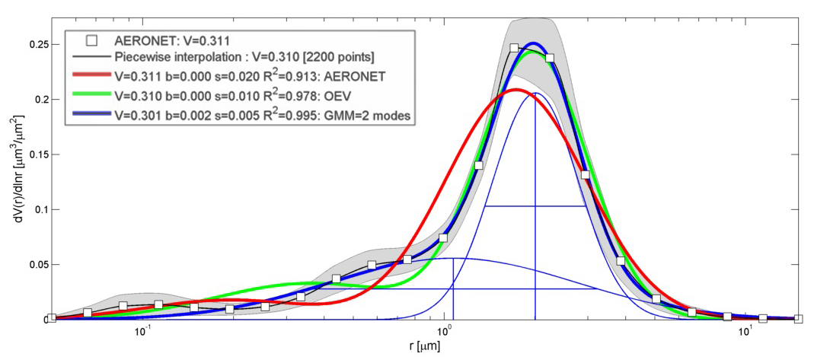
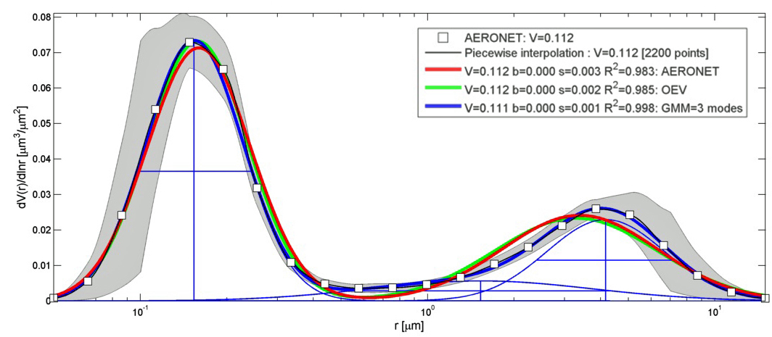
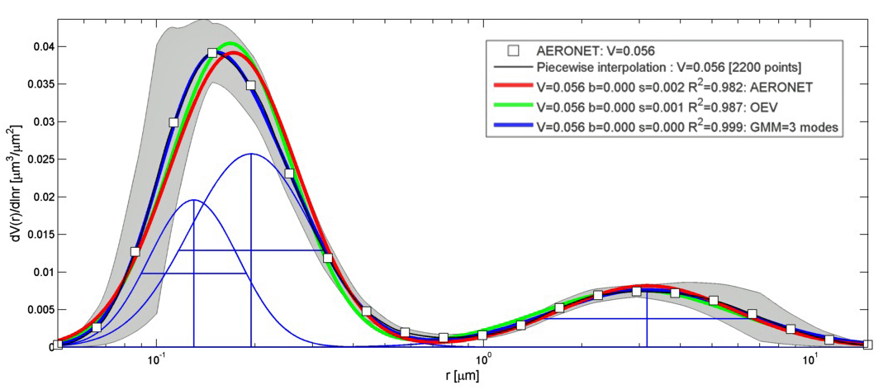

GMM V OEV V AERONET: “pure” aerosol cases
DUST (98%): Banizoumbou (16th March 2005) = “Quenched fine mode”
SMOKE (94%): Mongu (14th August 2003) = “Typical”
URBAN SO₂ (88%) : GFSC-Washington (17th August 2005) = “Typical”
SEA SALT (60%): Lanai (21st Jan 2002) = “Double coarse peak”
Michael Taylor, COMECAP 29th May, 2014: Remote Sensing Session
Notes:
Radiative forcing estimates in 2011 relative to 1750 and aggregated uncertainties for the
main drivers of climate change. Values are global average radiative forcing (RF15) partitioned according to
the emitted compounds or processes that result in a combination of drivers. The best estimates of the net
radiative forcing are shown as black diamonds with corresponding uncertainty intervals; the numerical values
are provided on the right of the figure, together with the confidence level in the net forcing (VH – very high, H
– high, M – medium, L – low, VL – very low). Albedo forcing due to black carbon on snow and ice is included
in the black carbon aerosol bar. Small forcings due to contrails (0.05 W m–2, including contrail induced
cirrus), and HFCs, PFCs and SF6 (total 0.03 W m–2) are not shown. Concentration-based RFs for gases can
be obtained by summing the like-coloured bars. Volcanic forcing is not included as its episodic nature makes
is difficult to compare to other forcing mechanisms. Total anthropogenic radiative forcing is provided for three
different years relative to 1750. For further technical details, including uncertainty ranges associated with
individual components and processes, see the Technical Summary Supplementary Material. {8.5; Figures
8.14–8.18; Figures TS.6 and TS.7}

Slide 28












GMM method: some more maths
$$f_{i}={a_{i}e}^{−{\left(\frac{lnr−b_{i}}{c_{i}}\right)}^{2}}$$
$$\frac{dV(r)}{dlnr}=\sum_{i=1..n}{{a_{i}e}^{−{\left(\frac{lnr−b_{i}}{c_{i}}\right)}^{2}}}$$
$$\frac{∂f_{i}}{∂a_{i}}={a_{i}e}^{−{\left(\frac{lnr−b_{i}}{c_{i}}\right)}^{2}}$$
$$V_{i}=\sqrt{π}(a_{i}c_{i})$$
$$\frac{∂f_{i}}{∂b_{i}}={\frac{2a_{i}(lnr−b_{i})}{c_{i}^{2}}e}^{−{\left(\frac{lnr−b_{i}}{c_{i}}\right)}^{2}}$$
$$r_{i}=e^{b_{i}}$$
Derivatives are
sensitive to N
$$σ_{i}=\frac{1}{\sqrt{2}}c_{i}$$
$$\frac{∂f_{i}}{∂c_{i}}={\frac{2a_{i}{(lnr−b_{i})}^{2}}{c_{i}^{3}}e}^{−{\left(\frac{lnr−b_{i}}{c_{i}}\right)}^{2}}$$
$${SE}_{i}=\sqrt{{\left(\frac{∂f_{i}}{∂a_{i}}×SE\left(a_{i}\right)\right)}^{2}+{\left(\frac{∂f_{i}}{∂b_{i}}×SE\left(b_{i}\right)\right)}^{2}+{\left(\frac{∂f_{i}}{∂c_{i}}×SE\left(c_{i}\right)\right)}^{2}}$$
$$upper bound=\sum_{i=1..n}{{a_{i}e}^{−{\left(\frac{lnr−b_{i}}{c_{i}}\right)}^{2}}}+1.96\sqrt{\sum_{i=1..n}{{\left({SE}_{i}\right)}^{2}}}$$
$$lower bound=\sum_{i=1..n}{{a_{i}e}^{−{\left(\frac{lnr−b_{i}}{c_{i}}\right)}^{2}}}−1.96\sqrt{\sum_{i=1..n}{{\left({SE}_{i}\right)}^{2}}}$$
Michael Taylor, COMECAP 29th May, 2014: Remote Sensing Session
Notes:
Radiative forcing estimates in 2011 relative to 1750 and aggregated uncertainties for the
main drivers of climate change. Values are global average radiative forcing (RF15) partitioned according to
the emitted compounds or processes that result in a combination of drivers. The best estimates of the net
radiative forcing are shown as black diamonds with corresponding uncertainty intervals; the numerical values
are provided on the right of the figure, together with the confidence level in the net forcing (VH – very high, H
– high, M – medium, L – low, VL – very low). Albedo forcing due to black carbon on snow and ice is included
in the black carbon aerosol bar. Small forcings due to contrails (0.05 W m–2, including contrail induced
cirrus), and HFCs, PFCs and SF6 (total 0.03 W m–2) are not shown. Concentration-based RFs for gases can
be obtained by summing the like-coloured bars. Volcanic forcing is not included as its episodic nature makes
is difficult to compare to other forcing mechanisms. Total anthropogenic radiative forcing is provided for three
different years relative to 1750. For further technical details, including uncertainty ranges associated with
individual components and processes, see the Technical Summary Supplementary Material. {8.5; Figures
8.14–8.18; Figures TS.6 and TS.7}

Slide 29

Potential impact: on AERONET optical properties
Lanai (Jan 2002)
V_{f} = 0.12 x AOD(1020) → AOD(1020) ≈ 8.33 V_{f}
V_{c} = 0.93 x AOD(1020) → AOD(1020) ≈ 1.08 V_{c}
r_{s}(AERONET) = 0.439µm but r_{s}(OEV) = 0.587µm
RE(AERONET-OEV) ≈ -28% for V_{f} and ≈ +7% for V_{c}
AOD(1020) for the fine mode ≈ 28% higher with OEV than AERONET
AOD(1020) for the coarse mode ≈ 7% lower with OEV than AERONET
Michael Taylor, COMECAP 29th May, 2014: Remote Sensing Session
Notes:
Radiative forcing estimates in 2011 relative to 1750 and aggregated uncertainties for the
main drivers of climate change. Values are global average radiative forcing (RF15) partitioned according to
the emitted compounds or processes that result in a combination of drivers. The best estimates of the net
radiative forcing are shown as black diamonds with corresponding uncertainty intervals; the numerical values
are provided on the right of the figure, together with the confidence level in the net forcing (VH – very high, H
– high, M – medium, L – low, VL – very low). Albedo forcing due to black carbon on snow and ice is included
in the black carbon aerosol bar. Small forcings due to contrails (0.05 W m–2, including contrail induced
cirrus), and HFCs, PFCs and SF6 (total 0.03 W m–2) are not shown. Concentration-based RFs for gases can
be obtained by summing the like-coloured bars. Volcanic forcing is not included as its episodic nature makes
is difficult to compare to other forcing mechanisms. Total anthropogenic radiative forcing is provided for three
different years relative to 1750. For further technical details, including uncertainty ranges associated with
individual components and processes, see the Technical Summary Supplementary Material. {8.5; Figures
8.14–8.18; Figures TS.6 and TS.7}

Slide 30

Global PM10 concentrations
Michael Taylor, COMECAP 29th May, 2014: Remote Sensing Session
Source: IPCC/AR5 (2013)
Notes:
Radiative forcing estimates in 2011 relative to 1750 and aggregated uncertainties for the
main drivers of climate change. Values are global average radiative forcing (RF15) partitioned according to
the emitted compounds or processes that result in a combination of drivers. The best estimates of the net
radiative forcing are shown as black diamonds with corresponding uncertainty intervals; the numerical values
are provided on the right of the figure, together with the confidence level in the net forcing (VH – very high, H
– high, M – medium, L – low, VL – very low). Albedo forcing due to black carbon on snow and ice is included
in the black carbon aerosol bar. Small forcings due to contrails (0.05 W m–2, including contrail induced
cirrus), and HFCs, PFCs and SF6 (total 0.03 W m–2) are not shown. Concentration-based RFs for gases can
be obtained by summing the like-coloured bars. Volcanic forcing is not included as its episodic nature makes
is difficult to compare to other forcing mechanisms. Total anthropogenic radiative forcing is provided for three
different years relative to 1750. For further technical details, including uncertainty ranges associated with
individual components and processes, see the Technical Summary Supplementary Material. {8.5; Figures
8.14–8.18; Figures TS.6 and TS.7}

Slide 31

Fine & coarse mode chemistry
Michael Taylor, COMECAP 29th May, 2014: Remote Sensing Session
After: Gerasopoulos et al (2007)
Notes:
Radiative forcing estimates in 2011 relative to 1750 and aggregated uncertainties for the
main drivers of climate change. Values are global average radiative forcing (RF15) partitioned according to
the emitted compounds or processes that result in a combination of drivers. The best estimates of the net
radiative forcing are shown as black diamonds with corresponding uncertainty intervals; the numerical values
are provided on the right of the figure, together with the confidence level in the net forcing (VH – very high, H
– high, M – medium, L – low, VL – very low). Albedo forcing due to black carbon on snow and ice is included
in the black carbon aerosol bar. Small forcings due to contrails (0.05 W m–2, including contrail induced
cirrus), and HFCs, PFCs and SF6 (total 0.03 W m–2) are not shown. Concentration-based RFs for gases can
be obtained by summing the like-coloured bars. Volcanic forcing is not included as its episodic nature makes
is difficult to compare to other forcing mechanisms. Total anthropogenic radiative forcing is provided for three
different years relative to 1750. For further technical details, including uncertainty ranges associated with
individual components and processes, see the Technical Summary Supplementary Material. {8.5; Figures
8.14–8.18; Figures TS.6 and TS.7}

Slide 32


Aerosol -radiation-cloud uncertainty is confidently LARGE
Source: IPCC/AR5 (2013)
Accurate V Precise
Michael Taylor, COMECAP 29th May, 2014: Remote Sensing Session
Notes:
Radiative forcing estimates in 2011 relative to 1750 and aggregated uncertainties for the
main drivers of climate change. Values are global average radiative forcing (RF15) partitioned according to
the emitted compounds or processes that result in a combination of drivers. The best estimates of the net
radiative forcing are shown as black diamonds with corresponding uncertainty intervals; the numerical values
are provided on the right of the figure, together with the confidence level in the net forcing (VH – very high, H
– high, M – medium, L – low, VL – very low). Albedo forcing due to black carbon on snow and ice is included
in the black carbon aerosol bar. Small forcings due to contrails (0.05 W m–2, including contrail induced
cirrus), and HFCs, PFCs and SF6 (total 0.03 W m–2) are not shown. Concentration-based RFs for gases can
be obtained by summing the like-coloured bars. Volcanic forcing is not included as its episodic nature makes
is difficult to compare to other forcing mechanisms. Total anthropogenic radiative forcing is provided for three
different years relative to 1750. For further technical details, including uncertainty ranges associated with
individual components and processes, see the Technical Summary Supplementary Material. {8.5; Figures
8.14–8.18; Figures TS.6 and TS.7}

Slide 33

Tropospheric aerosol lifetimes
Source: IPCC/AR5 (2013)
Michael Taylor, COMECAP 29th May, 2014: Remote Sensing Session
Notes:
Radiative forcing estimates in 2011 relative to 1750 and aggregated uncertainties for the
main drivers of climate change. Values are global average radiative forcing (RF15) partitioned according to
the emitted compounds or processes that result in a combination of drivers. The best estimates of the net
radiative forcing are shown as black diamonds with corresponding uncertainty intervals; the numerical values
are provided on the right of the figure, together with the confidence level in the net forcing (VH – very high, H
– high, M – medium, L – low, VL – very low). Albedo forcing due to black carbon on snow and ice is included
in the black carbon aerosol bar. Small forcings due to contrails (0.05 W m–2, including contrail induced
cirrus), and HFCs, PFCs and SF6 (total 0.03 W m–2) are not shown. Concentration-based RFs for gases can
be obtained by summing the like-coloured bars. Volcanic forcing is not included as its episodic nature makes
is difficult to compare to other forcing mechanisms. Total anthropogenic radiative forcing is provided for three
different years relative to 1750. For further technical details, including uncertainty ranges associated with
individual components and processes, see the Technical Summary Supplementary Material. {8.5; Figures
8.14–8.18; Figures TS.6 and TS.7}

